Slide 1
Lecture 10
The Cellular Network Planning

Slide 2
Impacting Factors of Growth
Different Technologies
Parties Charged
Prepaid Phones
Phone Numbers
Traditional Phone Service
……..

Slide 3
Infrastructure Network Topology
Infrastructure Network Topology –
  there is a fixed (wired) infrastructure that supports communication between mobile terminals and between mobile and fixed terminals.
  Designed for large coverage areas and multiple base stations
  Base stations serve as the hub of the network
  Communication between two wireless terminals must go through one (or more ) base station

Slide 4
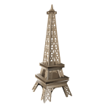
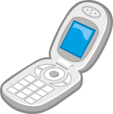
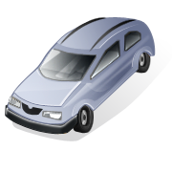
Infrastructure Wireless Network
Base Station
Mobile Unit
Mobile Communication Center
Mobile Unit
Fixed Comm. Network
Toll Office

Slide 5
Ad Hoc Network Topology
Reconfigurable networks that can operate without the need for a fixed infrastructure
Used by military or some special operations
Single-hop ad hoc network – every user terminal can communicate directly with any other user terminals
Multi-hop ad hoc network – every terminal should be aware of its neighboring terminals in its coverage area and to cooperate to carry messages across the network between widely spread terminals

Slide 6
Ad Hoc Networks
Single-Hop
Multi-Hop

Slide 7
Cellular Topology
A special case of infrastructure multi-BS network configuration that exploits the frequency reuse concept.
Dominant topology used in large scale terrestrial and satellite wireless networks
Invented by Bell Lab in 1970.

Slide 8
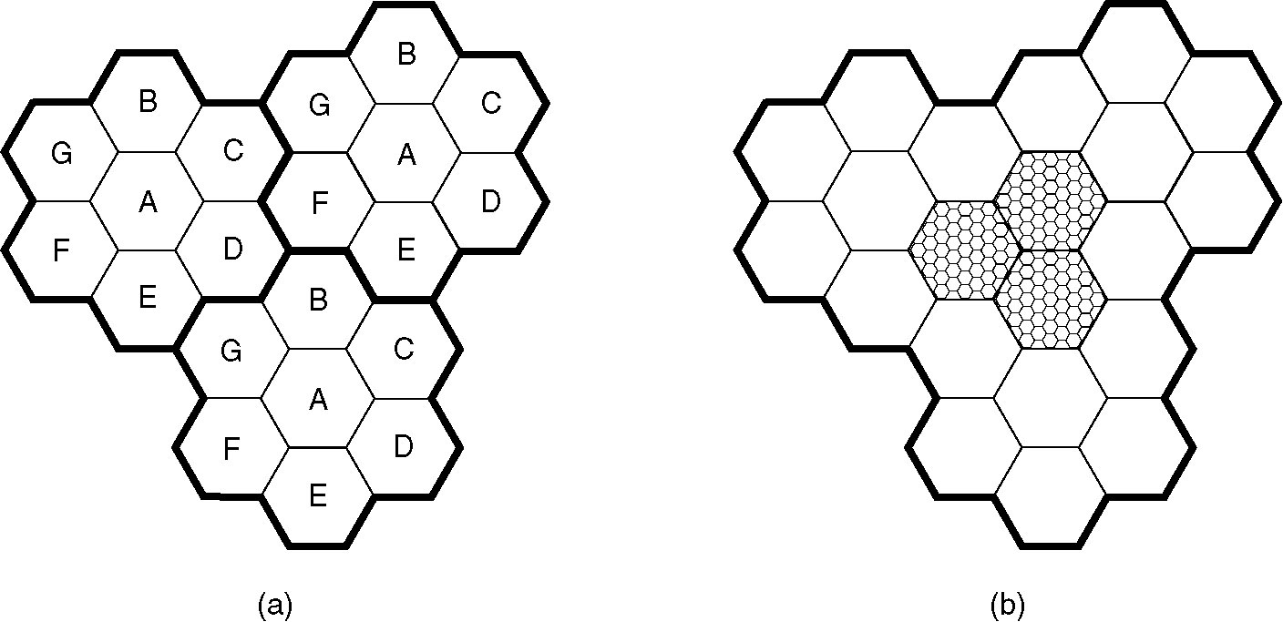
(a) Frequencies are not reused in adjacent cells.
(b) To add more users, smaller cells can be used.

Slide 9
Frequency Reuse
Frequency Reuse – Spatially reusing the available spectrum so that the same spectrum can support multiple users separated by a distance
Reason: Radio spectrum is one of the scarcest resources and every effort must be made to find ways of utilizing the spectrum efficiently and to employ architectures that can support as many users as possible.
Theory: same frequency spectrum can be employed without any interference provided the distance separating the transmitters is sufficient large and their transmitting power are small

Slide 10
Cellular Concept
Divide the coverage area into many contiguous smaller areas which are each served by its own radio station
Radio channels are allocated to these small area in an intelligent way so as to minimize interference, provide an adequate performance and cater to the traffic load in these areas
Each of these small areas is called cell and cells are grouped into clusters. The number of cells in a cluster is called the cluster size or frequency reuse factor.
Each cluster utilizes the entire available radio spectrum. The frequency bands have to be split into chunks and distributed among the cells of a cluster.

Slide 11
Cell Fundamentals
In practice, cell are of arbitrary shape (close to circle)
It is easier to derive insights of system design by visualizing all cells as having the same hexagon shape
Under the hexagon model, we have
D_{L} / R_{L} = SQRT(3N) → cochannel reuse ratio
D_{L} – distance between co-channel cells
R_{L} – cell radius
N – cluster size and can be taken on value i² + ij + j² where i and j are integers

Slide 12
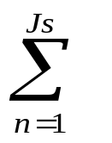
Signal to Interference ratio Calculation
Radio signal strength falls as some power of the distance called power-distance gradient or path-loss gradient. (α)
In general, the signal to interference ratio, S_{r} can be written as :
S_{r} = d₀^{α} / d_{n}^{α}
If there are J_{s} interference stations surrounding a given base station and the distance of the mobile terminal from the given base station is d₀ and its distance from the nth base station is d_{n}

